Slide 1
Issues with buying a used car (Update)
Colby Lewis
Tony Nguyen
Josue Cerritos
Hoang Vo
Kent Nguyen

Slide 2
The problem we are trying to solve
We are trying to identify common issues people face while trying to buy a used car.
Rather the problem is: Long annoying paperwork, not knowing what car to buy, the buying process being too long and overwhelming, etc.

Slide 3
Our First Go at market research
For the first set of interviews, we concentrated on trying to just get a wide variety of answer from many different segments.
Total of 60 interviews
Lowering the number of question made people more willing to answer
People had issues with the paperwork coming from a variety of reasons
We were able to get many people to give a little bit of their time by dressing up in school attire
People answered questions during extra activities for satisfaction.

Slide 4
Our First Go at market research (2nd edition)
60 interviews from different market segments in many locations
Dressing up in school attire while interviewing
Issues with the paperwork coming from a variety of reasons
Pros:
Getting a wide variety of answers from interviewees
Cons:
Too many questions
Not focused and too broad locations
Plan for the second interview:
Lowering the number of questions
Reducing the number of locations to conduct interview

Slide 5
What we did the second time around
The rainy season makes it hard for us to conduct the face-to-face interviews, so we tried to find some new information that could assist the project.
We made plan to target those whose cars were flooded during the previous storm

Slide 6
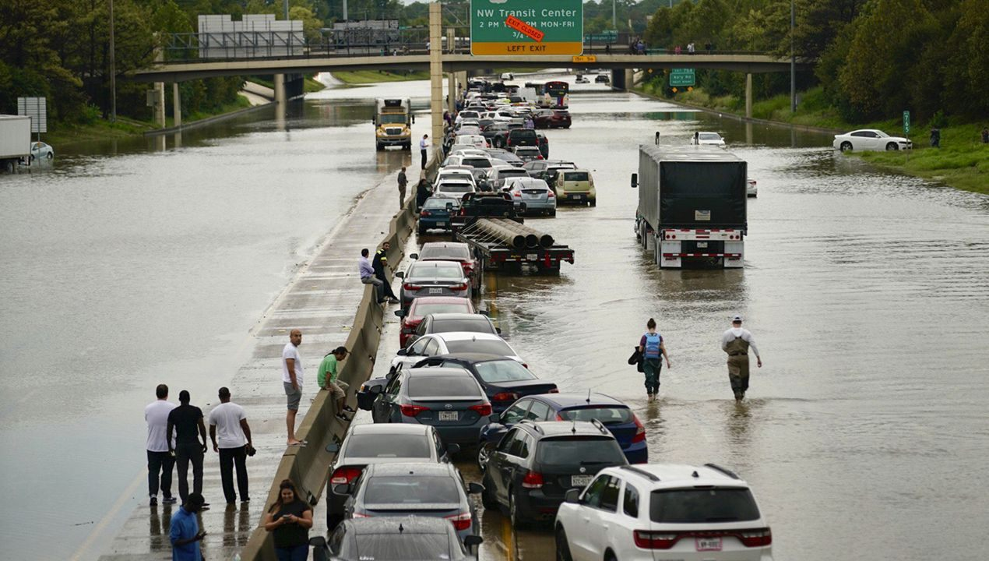
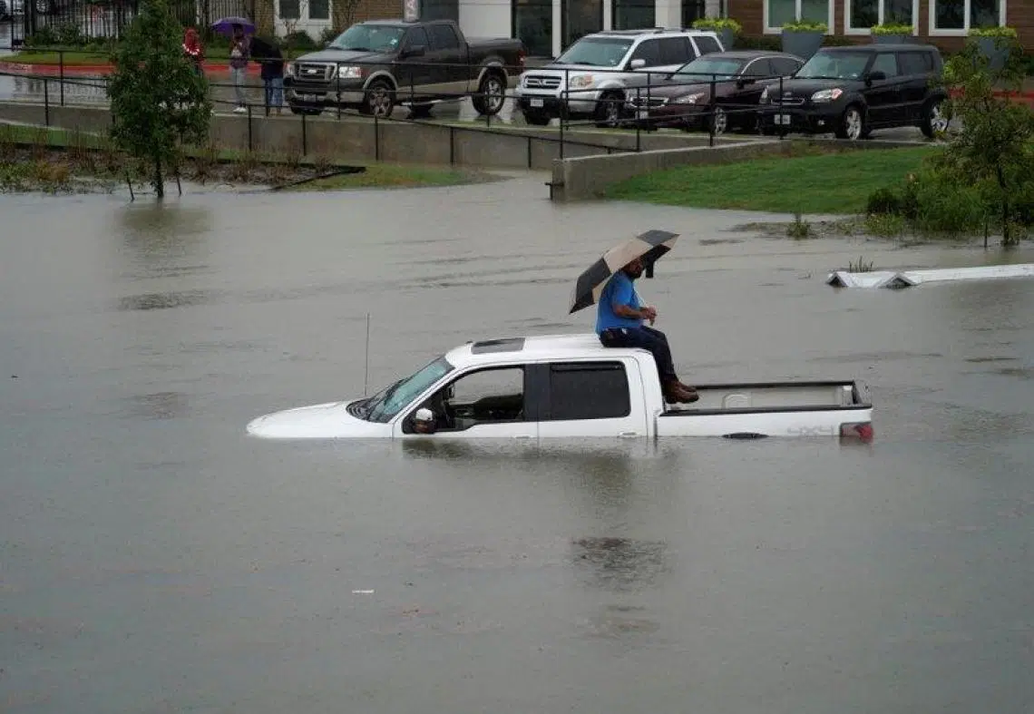
What we found out
The flood season made people abandon cars for survival.
Links of images: https://www.courthousenews.com/two-dead-1700-high-water-rescues-from-tropical-storm-imelda/

Slide 7
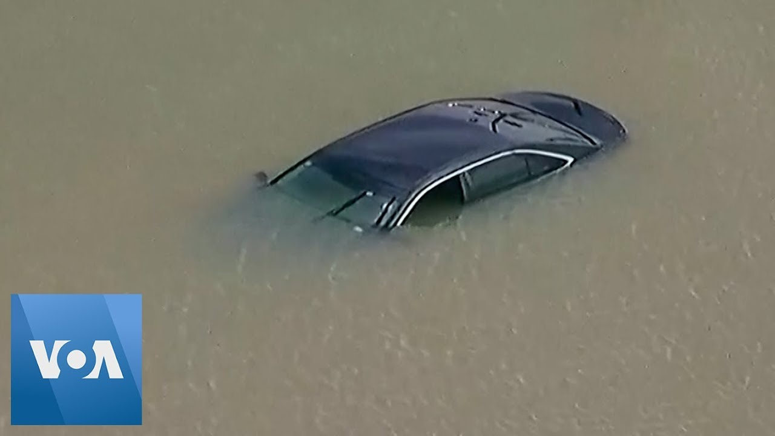
What we found out
Video: https://www.youtube.com/watch?v=xkd3TE_wi5U

Slide 8
Next on the to-do list
-Interview people who had cars stuck in flood.
-Try to gain access to be able to interview people at dealerships
-Brainstorm some possible ways to reduce the difficulty of dealing with the paperwork for the process
-Plan out the schedule for the rest of this project and set deadlines

